Slide 1
Click on the mouse to begin Mouse Maze Game

Slide 2
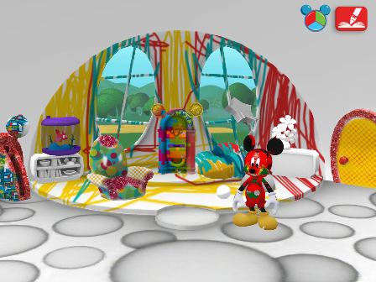
Go left around the circle once then go on

Slide 3
Click the sign to play again

Slide 4
You SUCK but to try again click the right picture.

